Slide 1
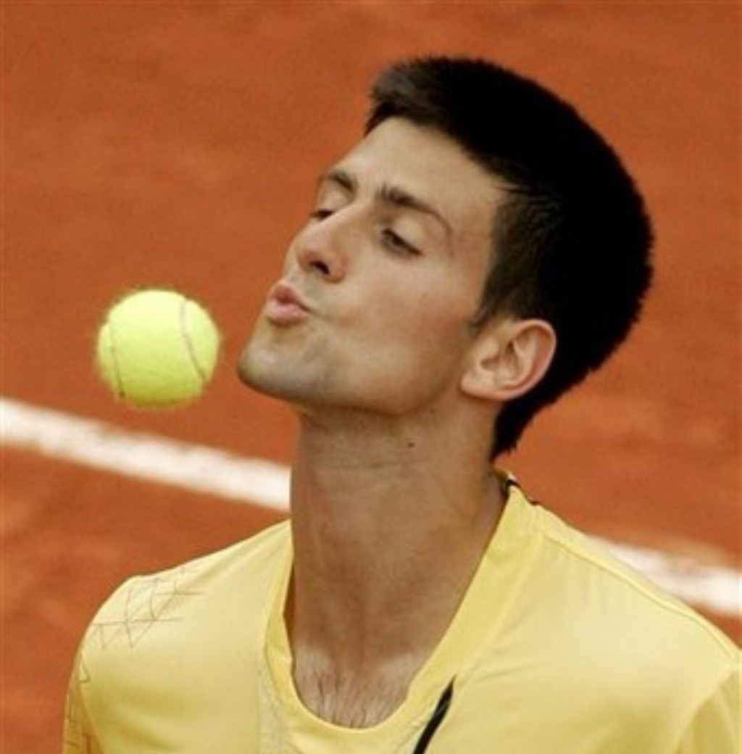


Slide 2
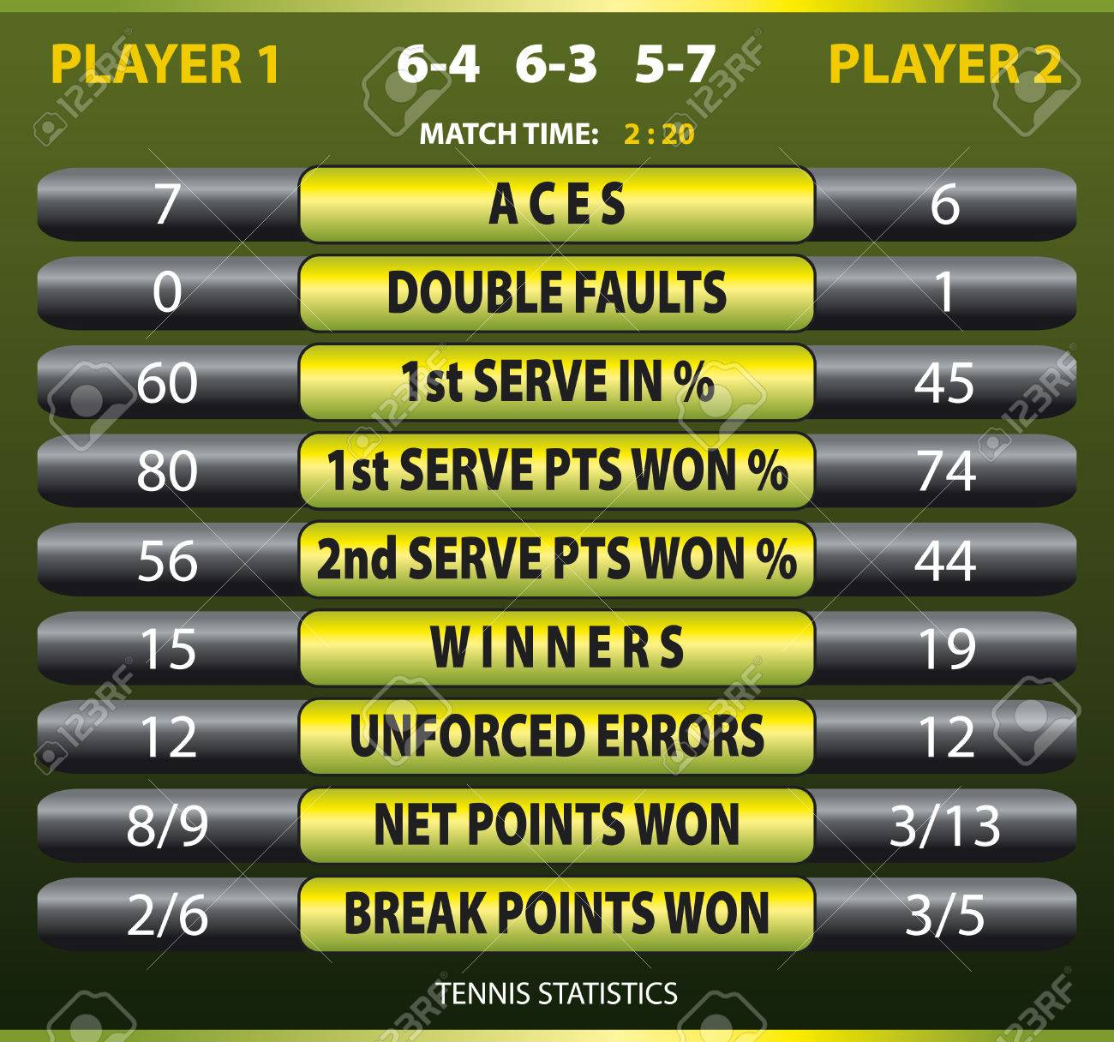
UFE
WNR
FSP
FSW
SSP
SSW

Slide 3
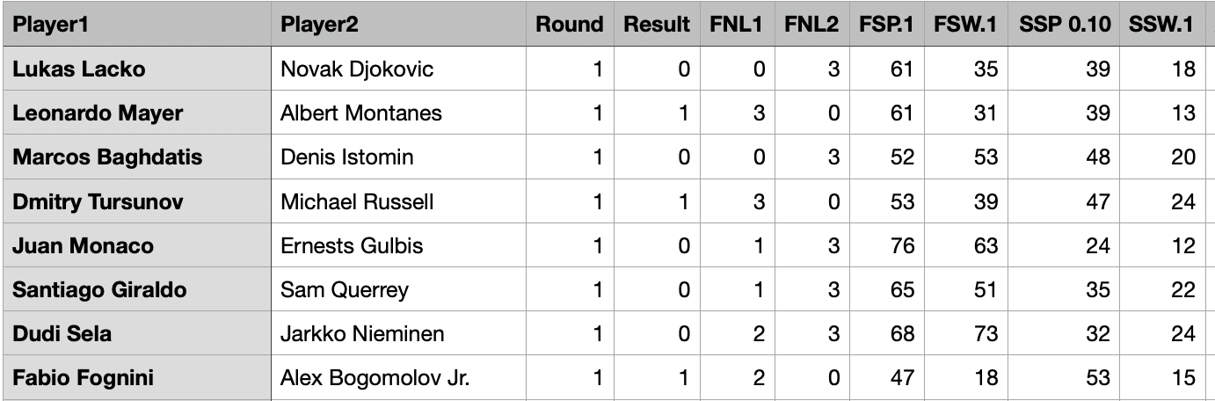
UCI

Slide 4
Frequency with which the player with the higher statistic won:
0.57 for FSP
0.39 for SSP
0.69 for FSW
0.58 for SSW
0.86 for Consistency (WNR - UFE)

Slide 5
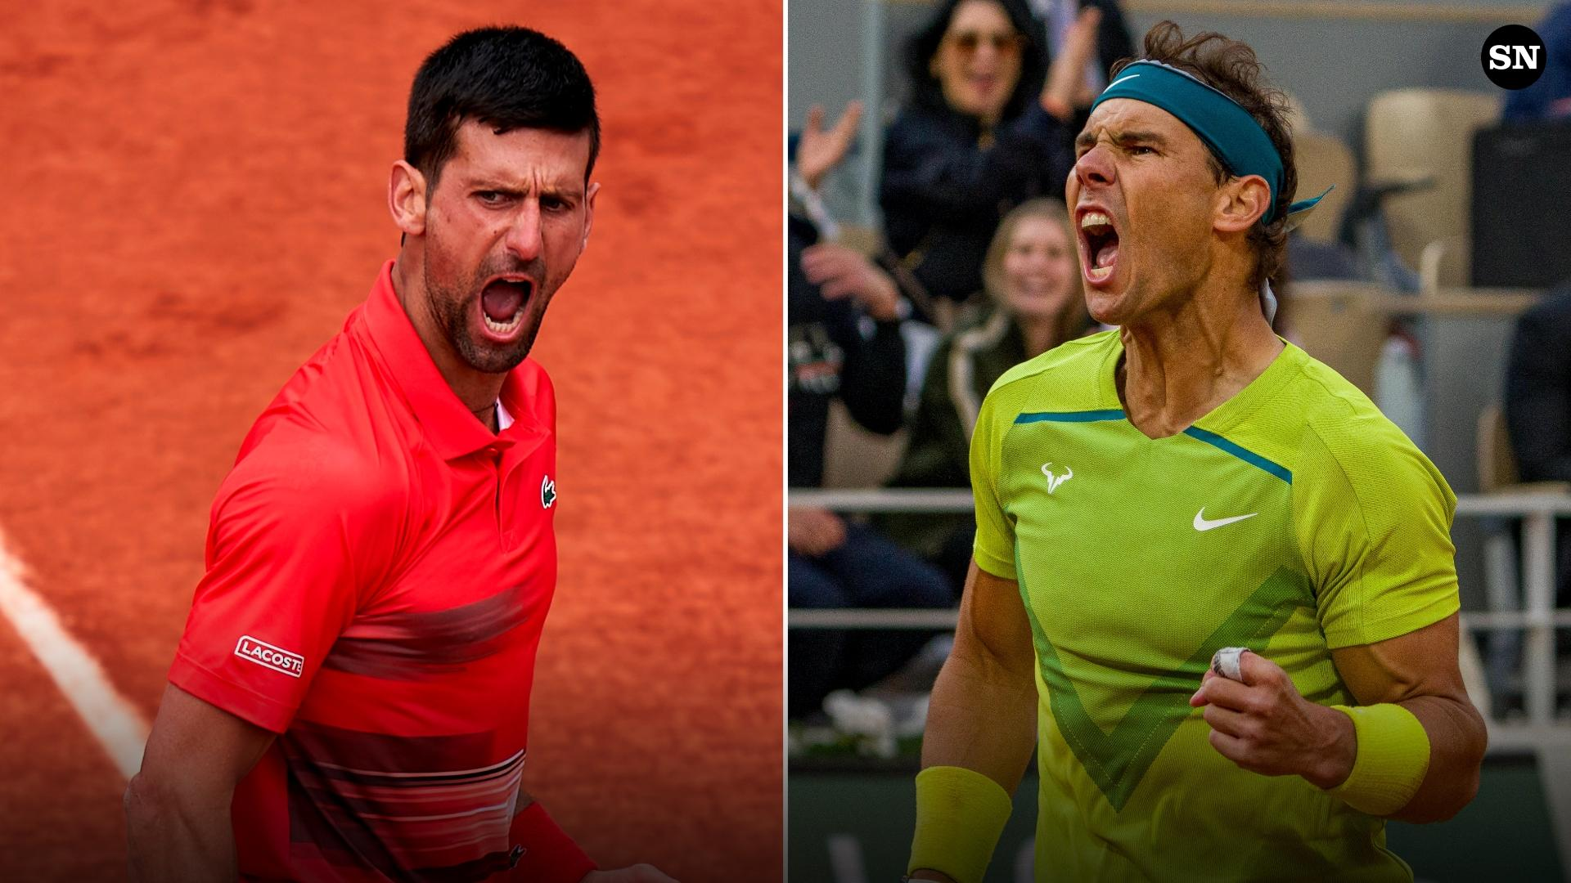

Slide 6
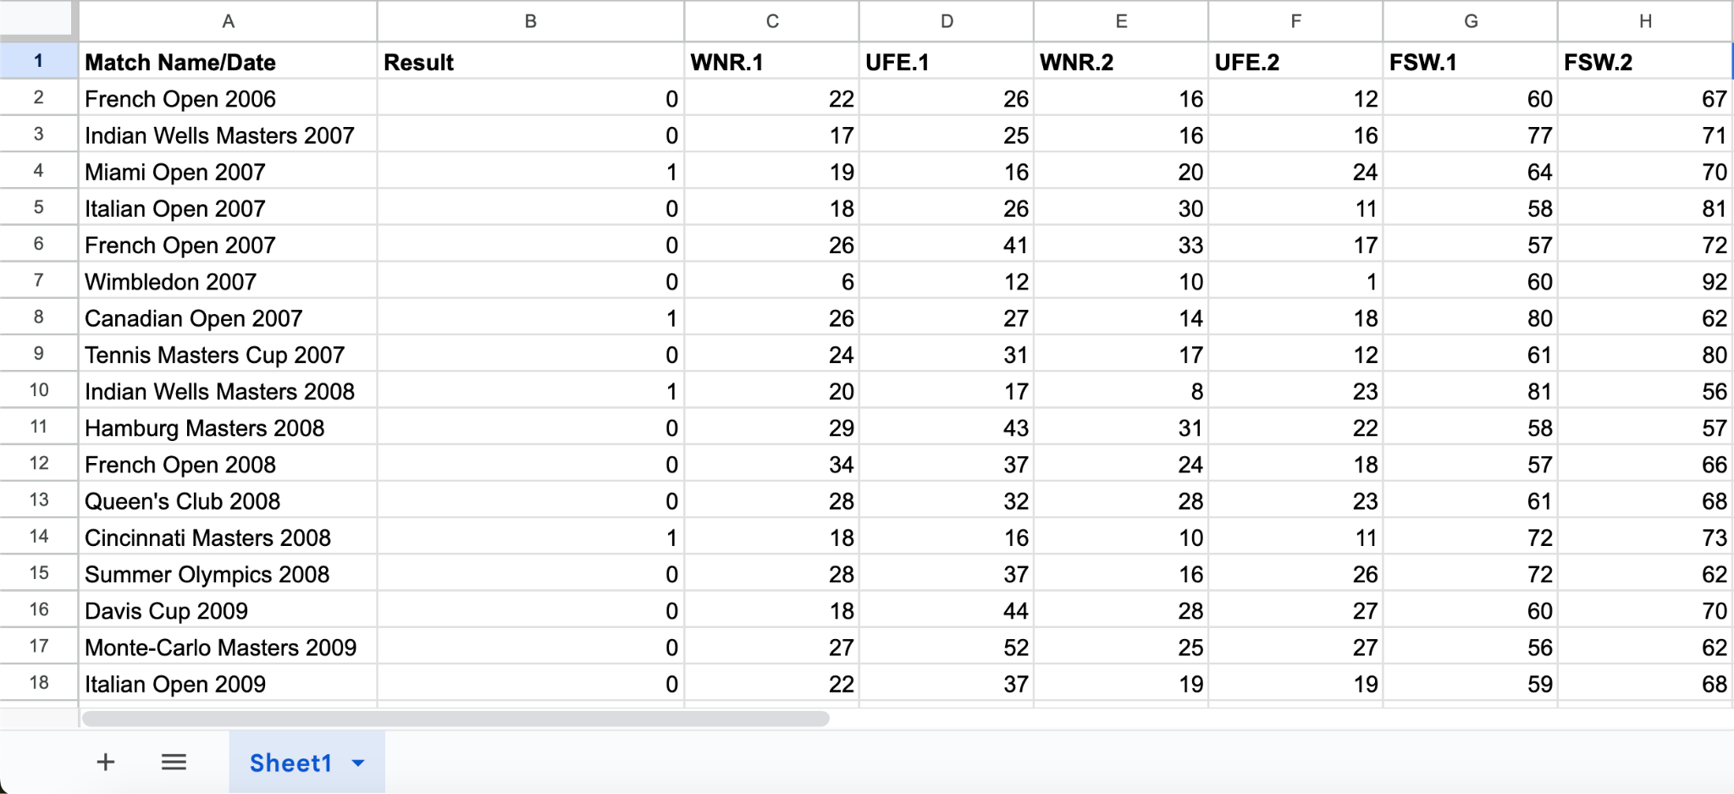
Player 1: Djokovic, Player 2: Nadal

Slide 7
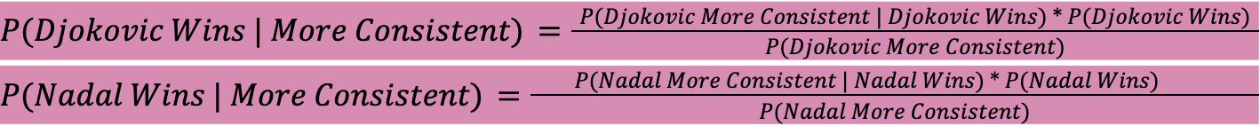
= 0.88
= 0.76

